Slide 1
Advanced Encryption Standard (AES) Md. Alamgir Hossain Senior Lecturer, Dept. of CSE, Prime University Mail: alamgir.cse14.just@gmail.com

Slide 2

Basic Information about AES
AES (Advanced Encryption Standard) is a widely used symmetric encryption algorithm.
It uses a fixed block size of 128 bits and supports key sizes of 128, 192, and 256 bits.
AES is a block cipher, which means it encrypts data in fixed-size blocks (128 bits) rather than streams.
AES is considered to be highly secure and efficient, and is used in many applications, such as securing wireless networks, encrypting sensitive data, and protecting financial transactions.

Slide 3
Basic Information about AES
AES uses a round-based structure and substitution-permutation network (SPN) structure.
AES is a US government standard and is approved by National Security Agency (NSA) for top secret information.
AES is widely accepted and used globally, as it is available in hardware and software form, and is included in most operating systems and encryption libraries.

Slide 4
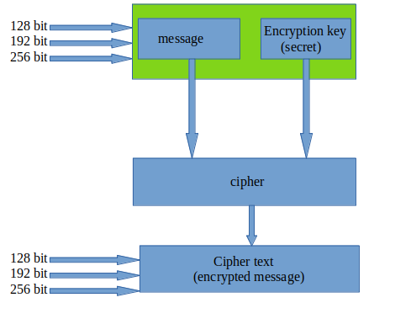
Diagrammatic Representation Flow of How AES Encrypts Data

Slide 5
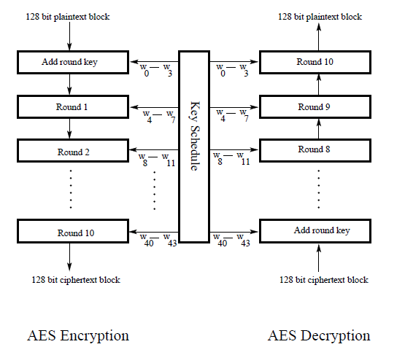
Structure of AES for the Case of 128- Bit Encryption Key

Slide 6
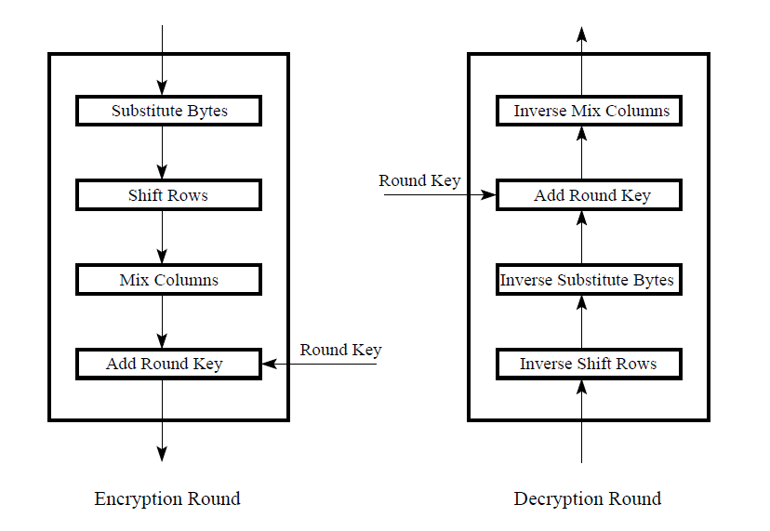
Operation in One Round

Slide 7
Overall Structure of AES

Slide 8
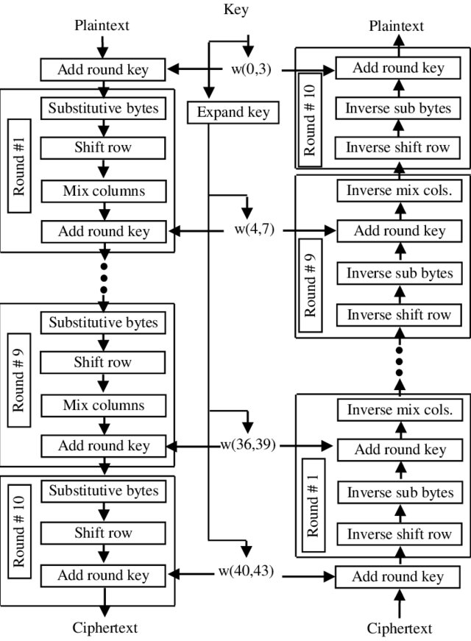

Slide 9
Step 1: Generation of Round Keys
This occurs through a process called key expansion where the original secret key is used to derive round keys by use of Rijndael’s key schedule algorithm.

Slide 10
AES Example - Input (128 bit key and message)
Plaintext in English: Two One Nine Two (16 ASCII characters, 1 byte each)
Translation into Hex:
Plaintext in Hex (128 bits): 54 77 6F 20 4F 6E 65 20 4E 69 6E 65 20 54 77 6F
T | w | o |  | O | n | e |  | N | i | n | e |  | T | w | o
54 | 77 | 6F | 20 | 4F | 6E | 65 | 20 | 4E | 69 | 6E | 65 | 20 | 54 | 77 | 6F

Slide 11
AES Example - Input (128 bit key and message)
Key in English: Thats my Kung Fu (16 ASCII characters, 1 byte each).
Translation into Hex:
Key in Hex (128 bits): 54 68 61 74 73 20 6D 79 20 4B 75 6E 67 20 46 75
T | h | a | t | s |  | m | y |  | K | u | n | g |  | F | u
54 | 68 | 61 | 74 | 73 | 20 | 6D | 79 | 20 | 4B | 75 | 6E | 67 | 20 | 46 | 75

Slide 12
AES Example - The first Roundkey
Key in Hex (128 bits): 54 68 61 74 73 20 6D 79 20 4B 75 6E 67 20 46 75
w[0] = (54, 68, 61, 74), w[1] = (73, 20, 6D, 79), w[2] = (20, 4B, 75, 6E), w[3] = (67, 20, 46, 75)
Do for w[4]:
circular byte left shift of w[3]: (20, 46, 75, 67) (1 byte rotation in column)
Byte Substitution (S-Box): (B7, 5A, 9D, 85)=>S[3]
W[4] = w[3] ⊕ S[3] ⊕ R[1] (N.B: Do for w[8, 12, 16, 20, 24, 28, 32, 36, 40)
w[5] = w[4] ⊕ w[1] = (91, 12, 91, 88), w[6] = w[5] ⊕ w[2] = (B1, 59, E4, E6),
w[7] = w[6] ⊕ w[3] = (D6, 79, A2, 93)

Slide 13
All RoundKeys
Round 0: 54 68 61 74 73 20 6D 79 20 4B 75 6E 67 20 46 75
Round 1: E2 32 FC F1 91 12 91 88 B1 59 E4 E6 D6 79 A2 93
Round 2: 56 08 20 07 C7 1A B1 8F 76 43 55 69 A0 3A F7 FA
Round 3: D2 60 0D E7 15 7A BC 68 63 39 E9 01 C3 03 1E FB
Round 4: A1 12 02 C9 B4 68 BE A1 D7 51 57 A0 14 52 49 5B
Round 5: B1 29 3B 33 05 41 85 92 D2 10 D2 32 C6 42 9B 69
Round 6: BD 3D C2 B7 B8 7C 47 15 6A 6C 95 27 AC 2E 0E 4E
Round 7: CC 96 ED 16 74 EA AA 03 1E 86 3F 24 B2 A8 31 6A
Round 8: 8E 51 EF 21 FA BB 45 22 E4 3D 7A 06 56 95 4B 6C
Round 9: BF E2 BF 90 45 59 FA B2 A1 64 80 B4 F7 F1 CB D8
Round 10: 28 FD DE F8 6D A4 24 4A CC C0 A4 FE 3B 31 6F 26

Slide 14
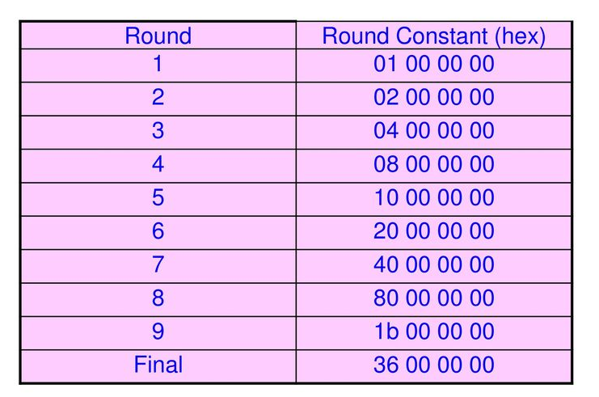
Round Constant Table

Slide 15
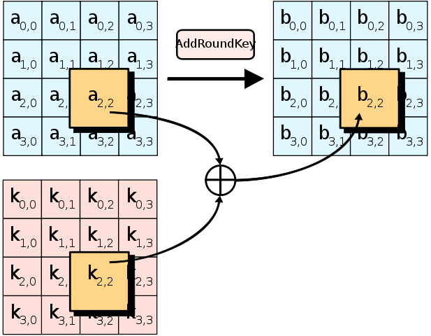
Step 1: Generation of Round Keys

Slide 16
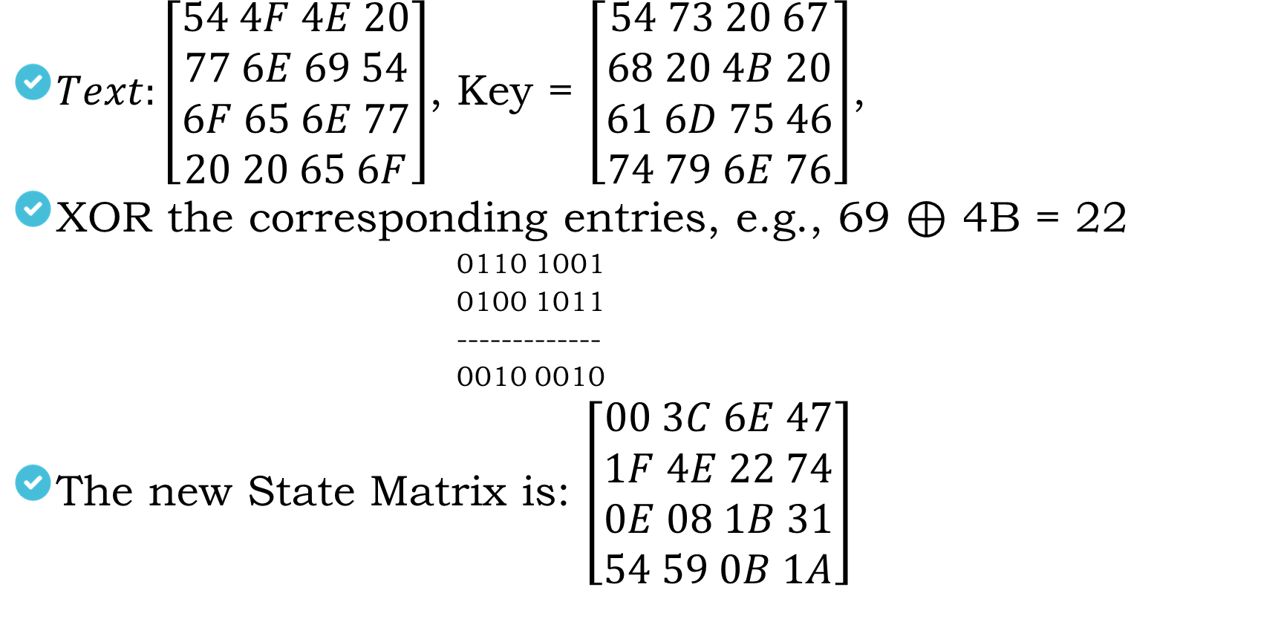
Add Round Key, Round-0
$Text:\left[\begin{aligned}54 4F 4E 20 \\ 77 6E 69 54 \\ 6F 65 6E 77 \\ 20 20 65 6F\end{aligned}\right]$, Key = $\left[\begin{aligned}54 73 20 67 \\ 68 20 4B 20 \\ 61 6D 75 46 \\ 74 79 6E 76\end{aligned}\right]$,
XOR the corresponding entries, e.g., 69 ⊕ 4B = 22
0110 1001
0100 1011
-------------
0010 0010
The new State Matrix is: $\left[\begin{aligned}00 3C 6E 47 \\ 1F 4E 22 74 \\ 0E 08 1B 31 \\ 54 59 0B 1A\end{aligned}\right]$

Slide 17
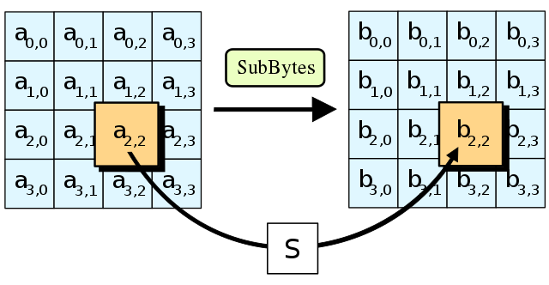
Round 1: Step-01, Substitution Bytes
This involves substituting the resultant data from previous step in a substituting table.

Slide 18
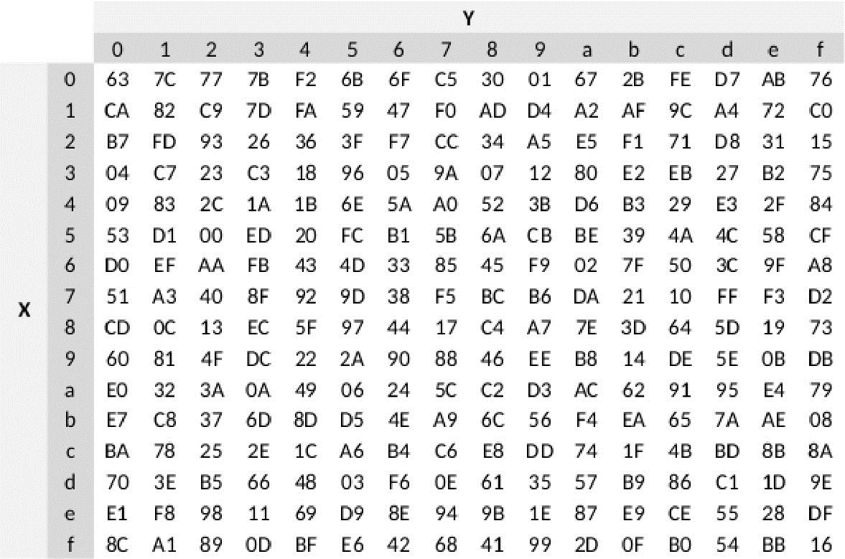
Round 1: Step-01, Substitution Bytes (S-Box)

Slide 19
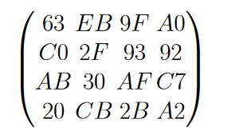
Round 1: Step-01, Substitution Bytes
Substitute each entry (byte) of the current state matrix by the corresponding entry in AES S-Box
For instance: byte 6E is substituted by an entry of S-Box in row 6 and column E, i.e., by 9F.
This leads to new State Matrix:

Slide 20
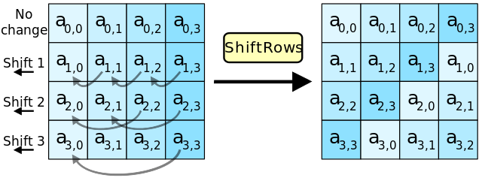
Round 1: Step-02, Shift Row
Four rows are shifted cyclically to the left by offsets of 0,1,2, and 3

Slide 21
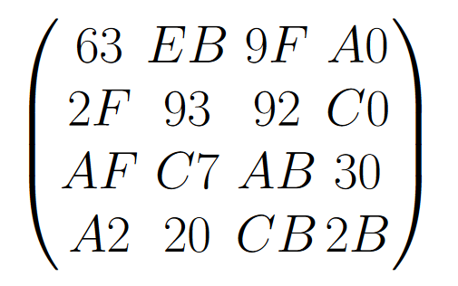
Round 1: Step-02, Shift Row
Current State Matrix:
The new State Matrix is:

Slide 22
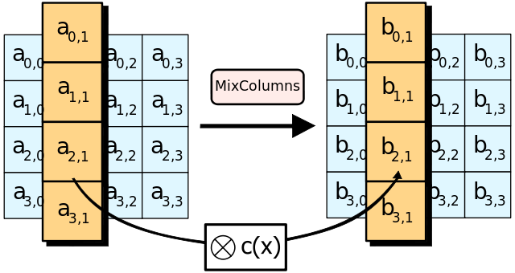
Round 1: Step-03, Mix Column
Performing the Mix Column operation “Rijndael Galois Field” will be applied.
Mix Column multiplies fixed matrix against current State Matrix:

Slide 23
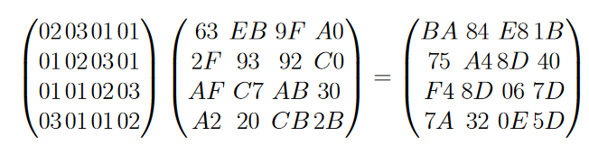
Round 1: Step-03, Mix Column
Mix Column multiplies fixed matrix against current State Matrix (Multiply and X-OR):
Entry BA is result of (02 • 63) ⊕ (03 • 2F ) ⊕ (01 • AF ) ⊕ (01 • A2):
02 • 63 = 00000010 • 01100011 = 11000110
03 • 2F = 01110001
01 • AF = AF = 10101111 and 01 • A2 = A2 = 10100010

Slide 24
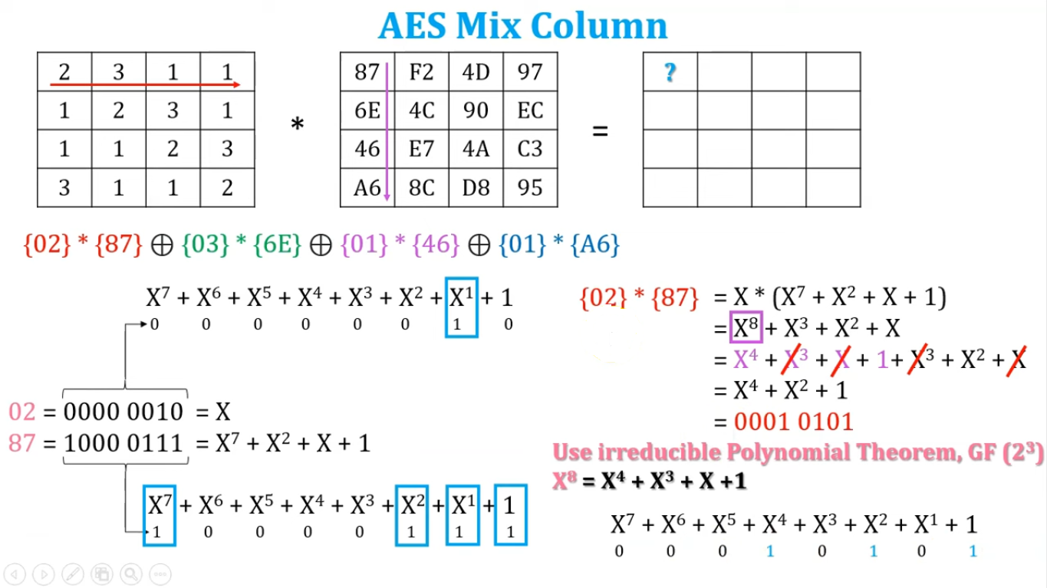
Value calculation using Galois’ field 2³ Polynomial Theorem

Slide 25
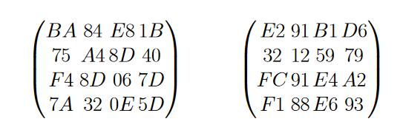
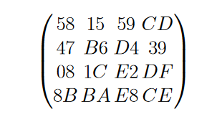
Add Roundkey, Round 1
State Matrix and Roundkey No.1 Matrix:
XOR yields new State Matrix:
AES output after Round 1: 58 47 08 8B 15 B6 1C BA 59 D4 E2 E8 CD 39 DF CE

Slide 26
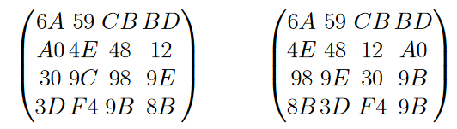
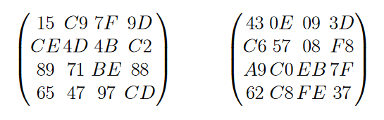
Round 2
After Substitute Byte and after Shift Rows:
After Mixcolumns and after Roundkey:

Slide 27
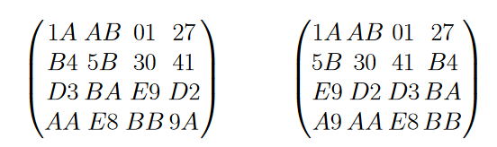
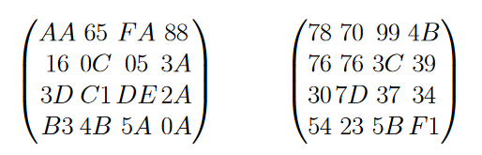
Round 3
After Substitute Byte and after Shift Rows:
After Mixcolumns and after Roundkey:

Slide 28
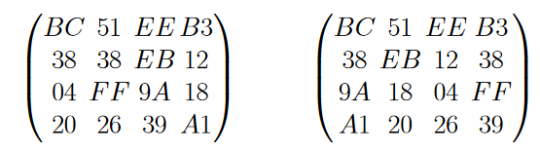
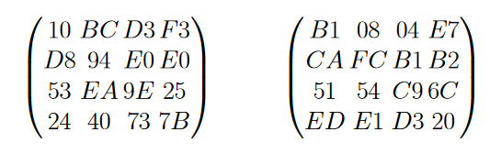
Round 4
After Substitute Byte and after Shift Rows:
After Mixcolumns and after Roundkey:

Slide 29
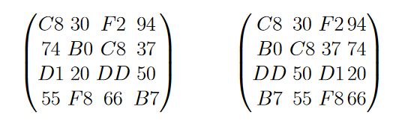
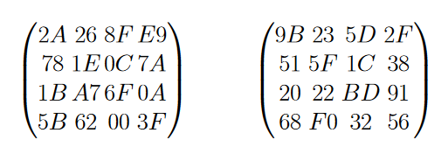
Round 5
After Substitute Byte and after Shift Rows:
After Mixcolumns and after Roundkey:

Slide 30
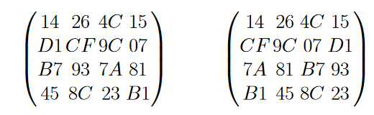
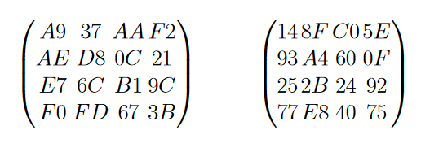
Round 6
After Substitute Byte and after Shift Rows:
After Mixcolumns and after Roundkey:

Slide 31
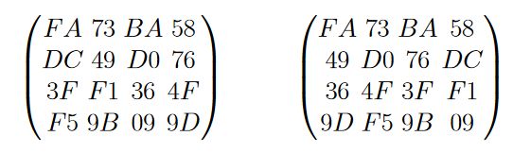
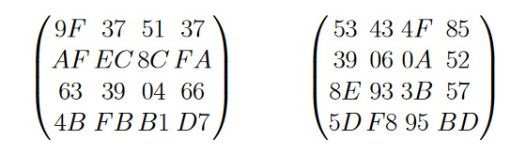
Round 7
After Substitute Byte and after Shift Rows:
After Mixcolumns and after Roundkey:

Slide 32
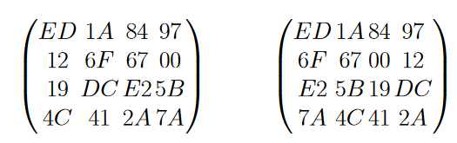
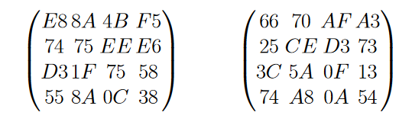
Round 8
After Substitute Byte and after Shift Rows:
After Mixcolumns and after Roundkey:

Slide 33
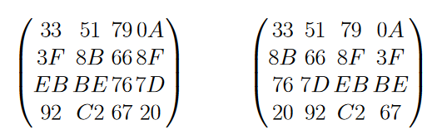
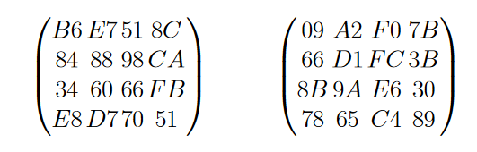
Round 9
After Substitute Byte and after Shift Rows:
After Mixcolumns and after Roundkey:

Slide 34
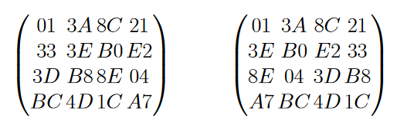
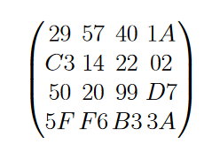
Round 10
After Substitute Byte and after Shift Rows:
After Roundkey (Attention: no Mix columns in last round):
Ciphertext: 29 C3 50 5F 57 14 20 F6 40 22 99 B3 1A 02 D7 3A

Slide 35
Decryption Process
The process of decryption of an AES ciphertext is similar to the encryption process in the reverse order. Each round consists of the four processes conducted in the reverse order −
Add round key
Mix columns
Shift rows
Byte substitution

Slide 36
Decryption Example???
Hopefully in the next birth!!

Slide 37
Advantages of AES
AES is considered to be highly secure due to its use of a complex round-based structure and substitution-permutation network (SPN) structure.
AES is efficient and fast, making it suitable for use in a wide variety of applications, including real-time communications and high-speed data processing.
AES is a widely accepted and used standard, with support built into many operating systems and encryption libraries.
AES is a flexible algorithm, supporting key sizes of 128, 192, and 256 bits, allowing for a high level of customization based on the level of security required.
AES has been adopted as a standard by many government and industry organizations around the world, which gives users confidence in its security and reliability.

Slide 38
Area where AES can be used!!
Network security: AES is commonly used to encrypt data transmitted over networks, such as the internet and wireless networks.
Cloud computing: AES is often used to encrypt data stored in the cloud and to secure data transmission between cloud servers and clients.
Internet of Things (IoT): AES is used to secure data transmission and storage in IoT devices, such as smart home devices and industrial control systems.
Mobile devices: AES is used to encrypt data stored on and transmitted by mobile devices, such as smartphones and tablets.
Disk encryption: AES is used to encrypt data stored on hard drives and other storage devices, such as USB drives and SD cards.
Software and apps: AES is used to encrypt sensitive data in various types of software and apps, such as password managers and file sharing programs.
Hardware: AES is used to encrypt data in hardware devices, such as secure tokens and smart cards.
Digital rights management (DRM): AES is used to encrypt and protect copyrighted content, such as movies and music.
Embedded systems: AES is used in embedded systems to secure boot process and communication between devices.
Government and military: AES is used to encrypt sensitive data by government and military organizations.

Slide 39
Research Areas of AES
“Enhancing Cybersecurity with Advanced AES Encryption Techniques”.
“Investigating the Effectiveness of AES in Protecting against Cyber Attacks”.
“A Comparative Study of AES and Other Symmetric Encryption Algorithms in Cyber Security”.
“AES in IoT Security: An Analysis of its Efficacy and Limitations”.
“Implementing AES Encryption for Secure Communication in Cyber-Physical Systems”.
“AES-based Encryption for Cloud Security: A Performance Evaluation”.
“AES in Mobile Device Security: Challenges and Solutions”.
“AES and Quantum-Safe Cryptography: A Research on Future of Cybersecurity”.
“AES in Industrial Control Systems: An Analysis of its suitability and limitations”.
“AES-based key management in wireless sensor networks for improved cybersecurity”.
ETC.

Slide 40
Research Areas of AES
“Enhancing Cybersecurity with Advanced AES Encryption Techniques”.
“Investigating the Effectiveness of AES in Protecting against Cyber Attacks”.
“A Comparative Study of AES and Other Symmetric Encryption Algorithms in Cyber Security”.
“AES in IoT Security: An Analysis of its Efficacy and Limitations”.
“Implementing AES Encryption for Secure Communication in Cyber-Physical Systems”.
“AES-based Encryption for Cloud Security: A Performance Evaluation”.
“AES in Mobile Device Security: Challenges and Solutions”.
“AES and Quantum-Safe Cryptography: A Research on Future of Cybersecurity”.
“AES in Industrial Control Systems: An Analysis of its suitability and limitations”.
“AES-based key management in wireless sensor networks for improved cybersecurity”.
ETC.

Slide 41
My Published Paper with AES
Title: Improving cloud data security through hybrid verification technique based on biometrics and encryption system
Link: https://www.tandfonline.com/doi/abs/10.1080/1206212X.2020.1809177

Slide 42
Thank You

